Slide 1
General overview

Slide 2
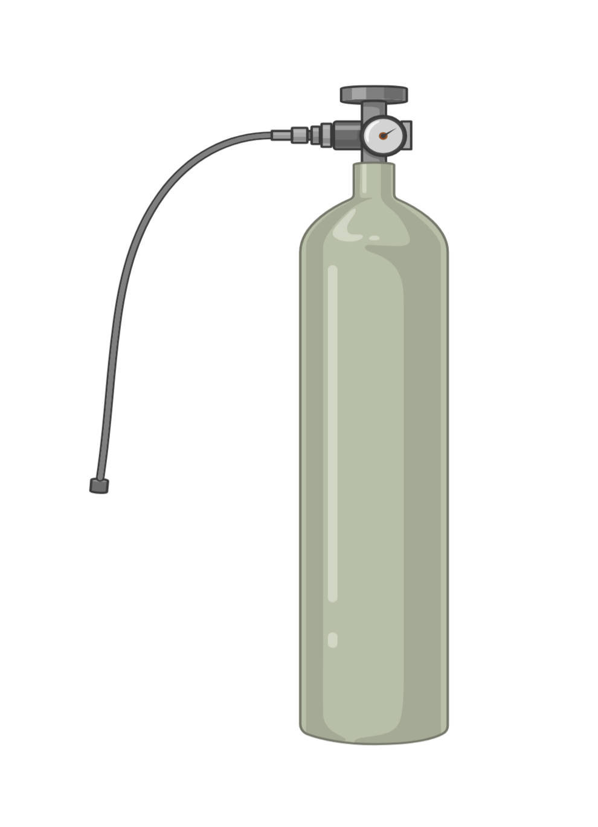
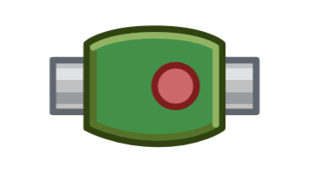
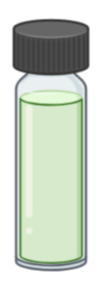
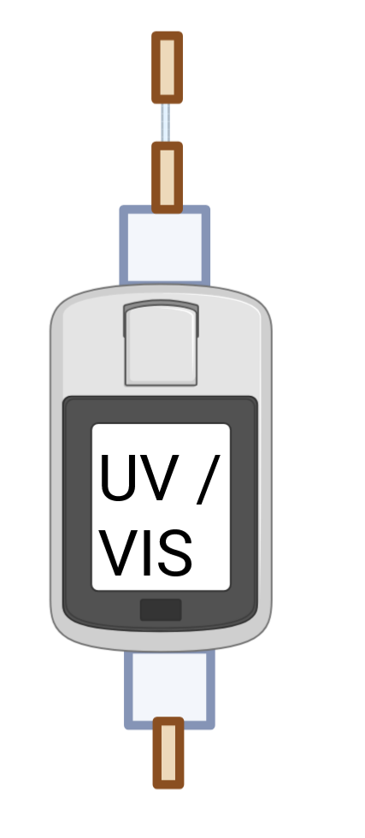
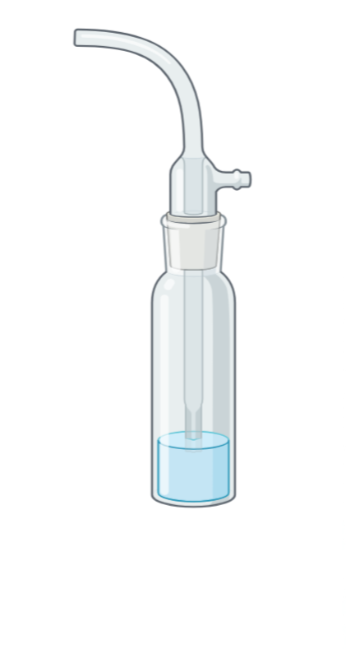
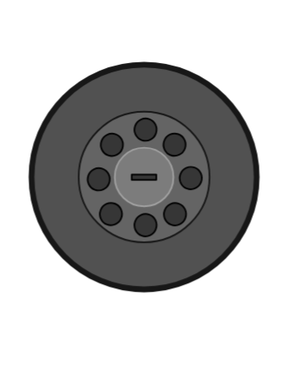
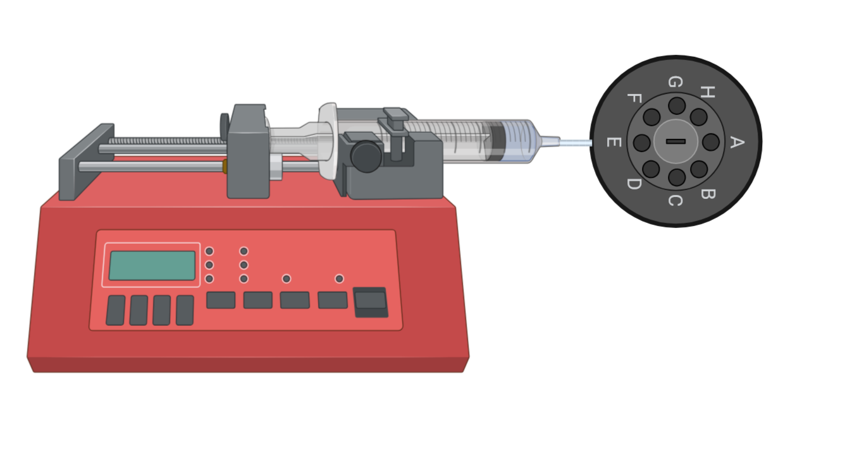
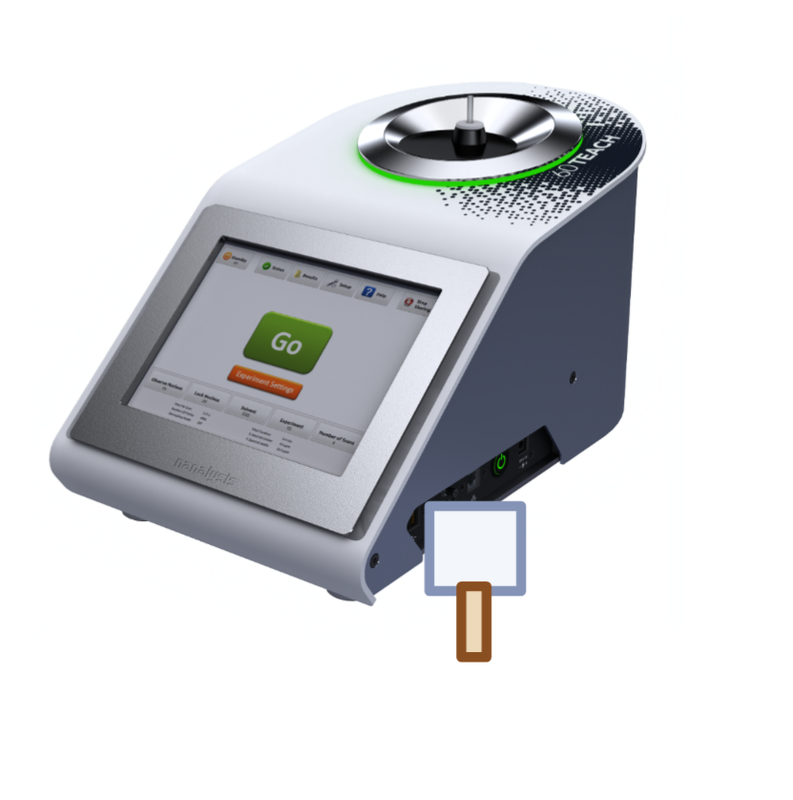
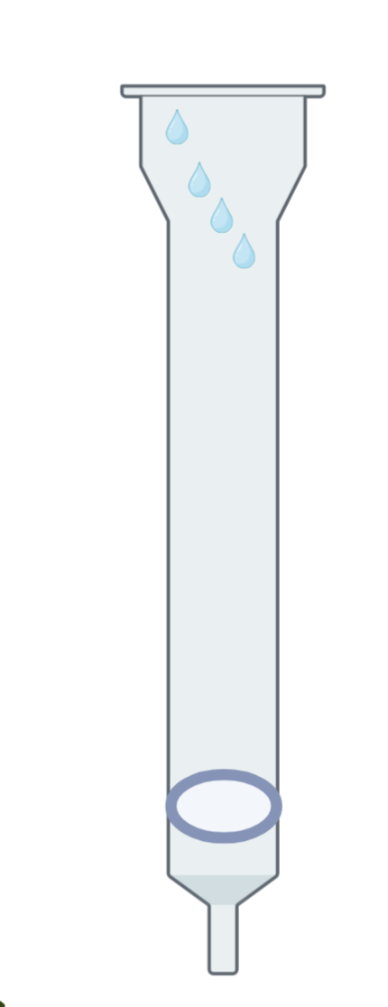
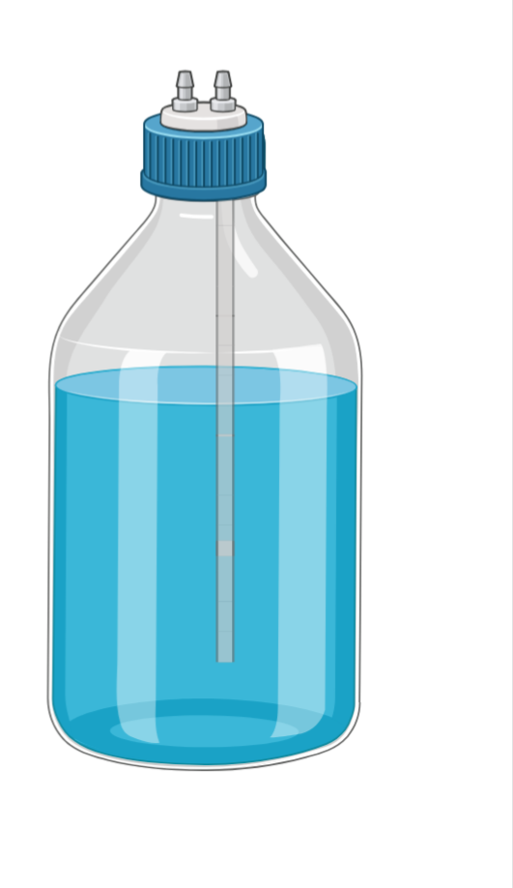
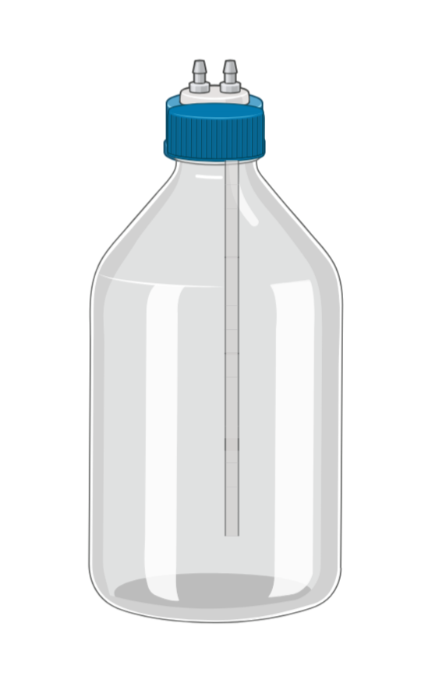
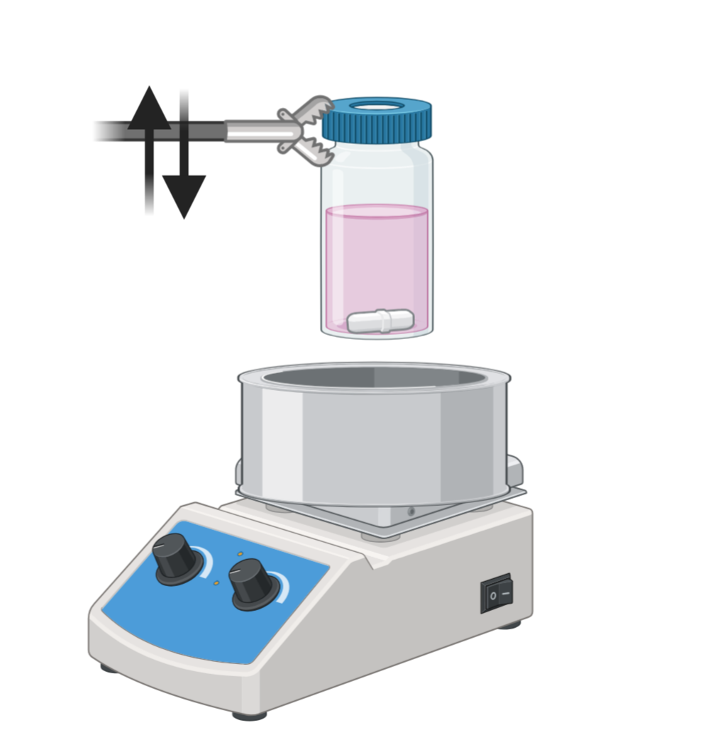
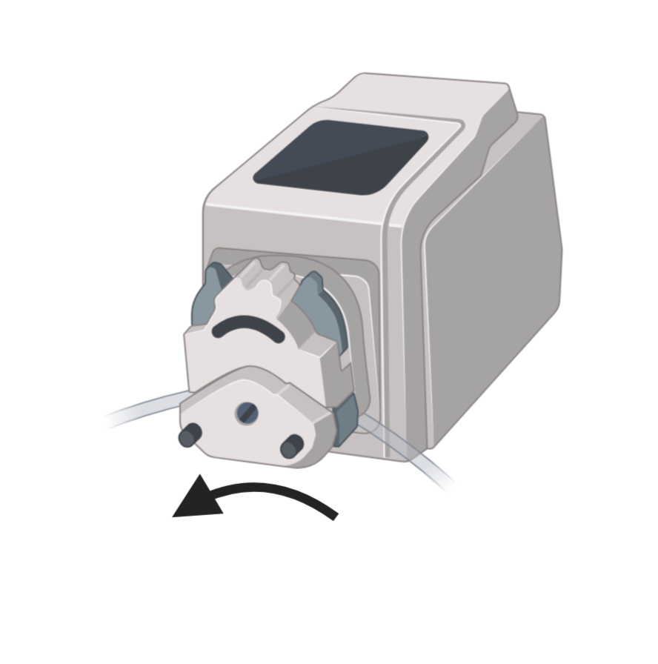
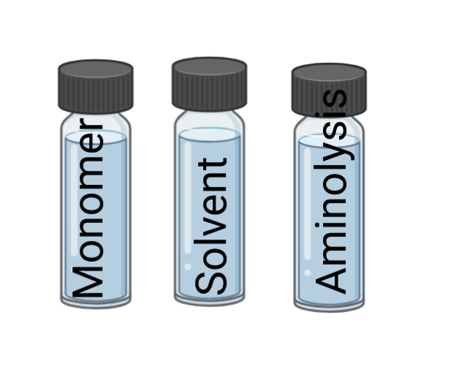
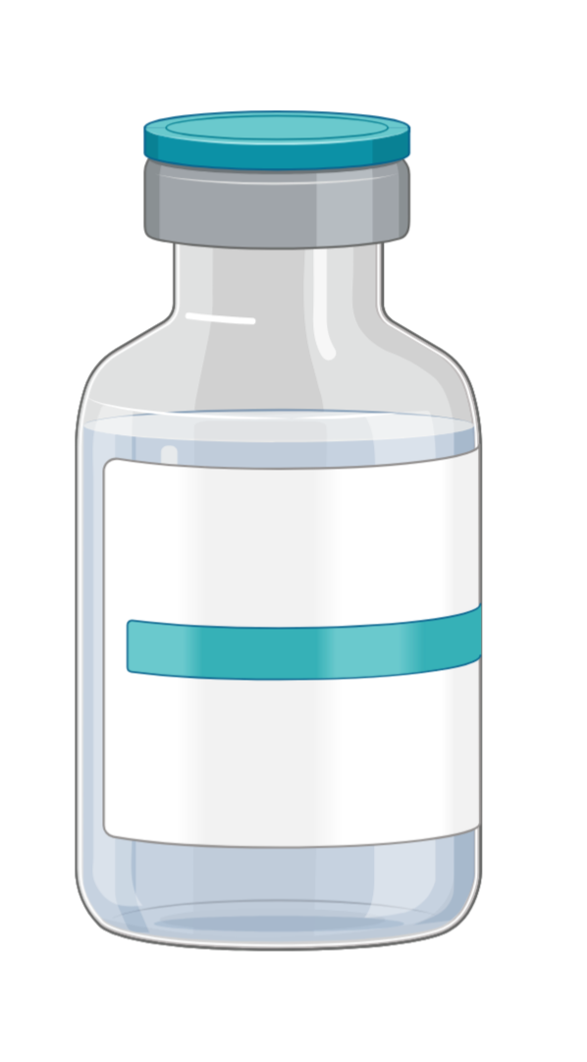
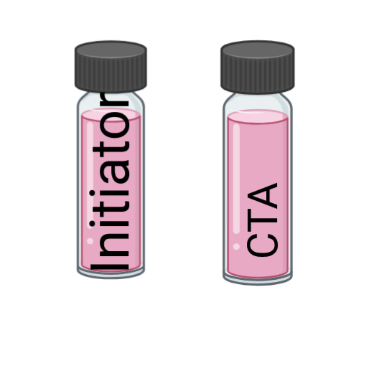
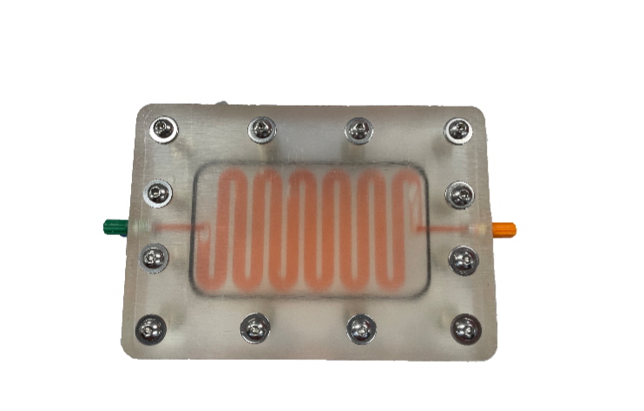
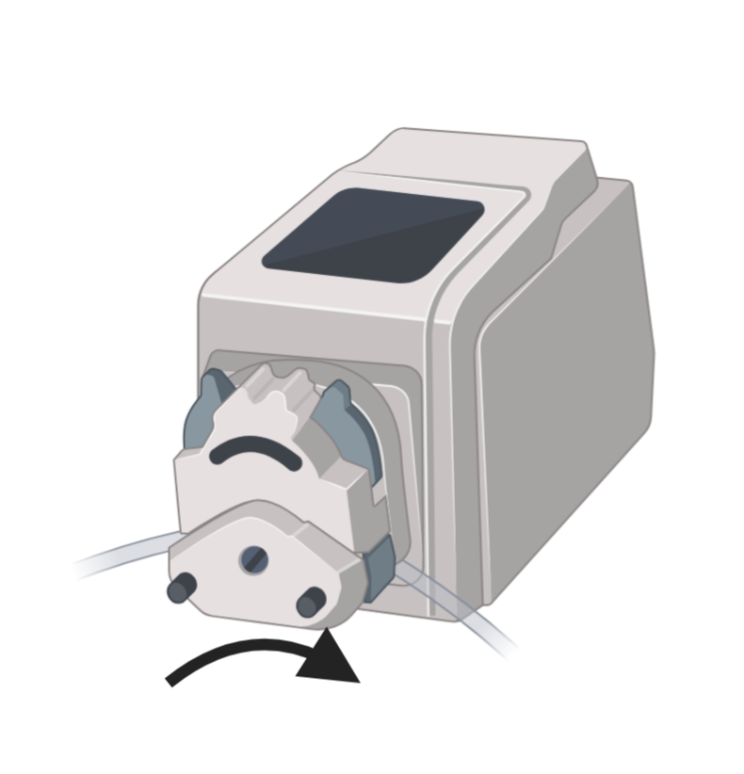
Argon supply
Gas in: always port H
Purge solvent in: always port G
To reaction vial: always port A
To waste: always port E
General overview
Deuterated solvent
Overpressure release
NMR
Gas manifold
Precipi-tation vessel
UV/VIS
Solenoid valve
MeOH
Waste
Linear actu-ator
10 mL syringe pump
Polymer pump
Heat and stir plate
For all connections, 0.75 mm i.d. tubing was used (o.d. = 1/16 “)
Purge
solvent
Stock solutions
Dialysis module
Purge
solvent
Eluent
Eluent pump

Slide 3
General overview with info about tubing or COM ports, etc

Slide 4
Argon supply
Gas in: always port H
Purge solvent in: always port G
To reaction vial: always port A
To waste: always port E
Volume of relevant tubing
Deuterated solvent
Overpressure release
Ca. 248 µL
Ca. 309 µL
NMR
Cuvette volume = 140 µL
Gas manifold
Ca. 177 µL
Ca. 88 µL
Ca. 199 µL
Precipi-tation vessel
Ca. 199 µL
UV/VIS
Ca. 353 µL
Ca. 252 µL
Ca. 2.4 mL (icluding NMR glass flow cell)
Ca. 110 µL
Solenoid valve
Ca. 132 µL
Ca. 177 µL
MeOH
Waste
Linear actu-ator
Ca. 292µL
Ca. 243 µL
10 mL syringe pump
Ca. 243 µL
Ca. 179 µL
Polymer pump
Ca. 138µL
Ca. 250µL
Ca. 110 µL
Heat and stir plate
Ca. 125µL
Ca. 3.2 mL
Ca. 167µL
For all connections, 0.75 mm i.d. tubing was used (o.d. = 1/16 “)
Ca. 167µL
Ca. 177 µL
Ca. 234 µL
Ca. 420 µL
Purge
solvent
Ca. 123 µL
Stock solutions
Dialysis module
Purge
solvent
Eluent
Ca. 3.2 mL
Ca. 256 µL
Eluent pump

Slide 5
Argon supply
Gas in: always port H
Purge solvent in: always port G
To reaction vial: always port A
To waste: always port E
Length of relevant tubing
Deuterated solvent
Overpressure release
Ca. 56 cm
Ca. 70 cm
NMR
Gas manifold
Ca. 40 cm
Ca. 20 cm
Ca. 45 cm
Precipi-tation vessel
Ca. 45 cm
UV/VIS
Ca. 80 cm
Ca. 57 cm
Ca. 73 cm + NMR glass flow cell
Ca. 25 cm
Solenoid valve
Ca. 30 cm
Ca. 40 cm
MeOH
Waste
Linear actu-ator
Ca. 70 cm
Ca. 55 cm
10 mL syringe pump
Ca. 55 cm
Ca. 43 cm
Polymer pump
Ca. 33 cm
Ca. 60 cm
Ca. 25 cm
Heat and stir plate
Ca. 30 cm
Ca. 10 cm
Ca. 40 cm
For all connections, 0.75 mm i.d. tubing was used (o.d. = 1/16 “)
Ca.40 cm
Ca. 40 cm
Ca. 53 cm
Ca. 75 cm
Purge
solvent
Stock solutions
Dialysis module
Purge
solvent
Eluent
Ca.10 cm
Ca. 28 cm
Ca. 58 cm
Eluent pump

Slide 6
Argon supply
Gas in: always port H
Purge solvent in: always port G
To reaction vial: always port A
To waste: always port E
Overview of COM ports, etc.
COM12
Deuterated solvent
Overpressure release
USB
NMR
Gas manifold
COM7
Adress: 2
Precipi-tation vessel
?
UV/VIS
COM12
COM12
Solenoid valve
MeOH
Waste
COM7 Adress: 1
Linear actu-ator
10 mL syringe pump
COM7
Adress: 3
Polymer pump
COM14
COM16
Adress: 2
Heat and stir plate
COM7
Adress: 4
For all connections, 0.75 mm i.d. tubing was used (o.d. = 1/16 “)
COM15
Adress: 1
Purge
solvent
Stock solutions
Dialysis module
Purge
solvent
Eluent
Eluent pump

Slide 7
Argon supply
Gas in: always port H
Purge solvent in: always port G
To reaction vial: always port A
To waste: always port E
In Medusa Graph (for most liquid transfers) - Denomination
COM12
Deuterated solvent
“Gas_Valve”
“Gas_Reservoir_Vessel”
Overpressure release
USB
NMR
“Precipitation_Vessel_Dispense”
“Precipitation_Pump”
“Deuterated_Solvent”
“UV_VIS”
Gas manifold
COM7
Adress: 2
“NMR”
Precipi-tation vessel
?
UV/VIS
“Precipitation_Valve”
COM12
“Methanol_Vessel”
“Waste_Vessel”
“Analytical_Pump”
COM12
“Reaction_Vial”
Solenoid valve
“Linear_Actuator”
“Precipitation_Vessel_Solenoid”
MeOH
Waste
COM7 Adress: 1
Linear actu-ator
COM7
Adress: 3
“Solvent_Monomer_Modification_Pump”
10 mL syringe pump
“Polymer_Peri_Pump”
COM14
Polymer pump
“Hotplate”
COM16
Adress: 2
Heat and stir plate
“Initiator_CTA_Pump”
COM7
Adress: 4
For all connections, 0.75 mm i.d. tubing was used (o.d. = 1/16 “)
“Modification_Vessel”
“Purge_Solvent_Vessel_1”
“CTA_Vessel”
“Monomer_Vessel”
“Purge_Solvent_Vessel_2”
“Initiator_Vessel”
COM15
Adress: 1
“Solvent_Vessel”
Purge
solvent
Stock solutions
“Solvent_Peri_Pump”
Dialysis module
Purge
solvent
Eluent
Eluent pump

Slide 8
Overview of individual modules

Slide 9
Gas in: always port H
Purge solvent in: always port G
To reaction vial: always port A
To waste: always port E
Module 1 – Polymerization module
Deuterated solvent
Overpressure release
Argon supply
NMR
Gas manifold
Waste
Linear actu-ator
10 mL syringe pump
Heat and stir plate
0. Manual preparation of stock solutions (CTA, AIBN, Solvent, Monomer); Preheating of heat and stir plate.
Formulation of polymerization solution.
2. Deoxygenation for 20 min with argon sparging.
3. Insertion of polymerization vial to heat block.
4. Online monitoring of conversion.
5. After 80% conversion, removal from heat block.
Purge
solvent
Stock solutions
Purge
solvent

Slide 10
Gas in: always port H
Purge solvent in: always port G
To reaction vial: always port A
To waste: always port E
Module 2 – Dialysis module
Deuterated solvent
Argon supply
Overpressure release
NMR
Start dialysis pumps and counterflow polymer and eluent.
Monitor decaying vinyl signal in NMR (until again 90% of signal gone)
Pump polymer back to vial
Gas manifold
Linear actu-ator
10 mL syringe pump
Polymer pump
Heat and stir plate
Dialysis module
Purge
solvent
Eluent
Waste
Eluent pump

Slide 11
Gas in: always port H
Purge solvent in: always port G
To reaction vial: always port A
To waste: always port E
Module 3 – Endgroup modification module
Argon supply
Deoxygenation by argon sparging (for 10 min)
Addition of aminolysis agent in DMSO (Octylamine + Na2S2O4 (as antioxidant))
Start stirring (reaction at room temperature)
Monitor decaying UV/Vis peak around 520 nm
After full decay, go back to module 2 and do dialysis for 4 hours
Gas manifold
UV/VIS
Linear actu-ator
10 mL syringe pump
Polymer pump
Heat and stir plate
Purge
solvent
Stock solutions
Dialysis module
Purge
solvent
Eluent
Waste
Eluent pump

Slide 12
Gas in: always port H
Purge solvent in: always port G
To reaction vial: always port A
To waste: always port E
Module 4 – Precipitation module
Argon supply
Gas manifold
Precipi-tation vessel
Solenoid valve
MeOH
Waste
Purge
solvent
Linear actu-ator
Pump methanol (ca. 30 mL) into precipitation column (open corresponding side of solenoid valve)
Open other side of solenoid and apply argon flow from bottom through methanol
Aspirate and dispense polymer into methanol from top
Remove methanold by aspiration with syringe pump and dispose of it
Add more methanol (ca. 20 mL) and bubble argon through for 5 min
Aspirate methanol and dispose of it
Dry polymer on frit with argon flow from bottom
(Potentially aspirate DCM and dissolve polymer and put it into a vial elsewhere)
Clean the whole setup by purging everything with purge solvent
Heat and stir plate

